Slide 1
2. Conditional probability

Slide 2
Contents
Conditional probability
Bayes Formula
Independent Events
P(ꞏ|F) Is a Probability

Slide 3
Coins game ----understand conditional probability
Toss 3 coins. You win if at least two come out heads
S = { HHH, HHT, HTH, HTT, THH, THT, TTH, TTT }
equally likely outcomes
W = { HHH, HHT, HTH, THH }
P(W) = |W|/|S| = 1/2

Slide 4
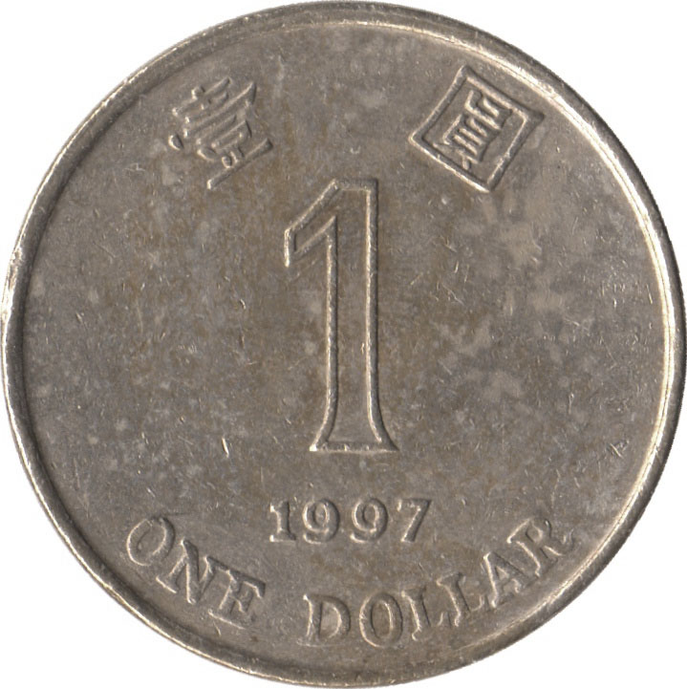
Coins game ----understand conditional probability
The first coin was just tossed and it came out
tails. How does this affect your chances?
S = { HHH, HHT, HTH, HTT, THH, THT, TTH, TTT }
equally likely outcomes
reduced sample
space F
W = { HHH, HHT, HTH, THH }
P(W | F)
= |W F|/|F|
= 1/4

Slide 5


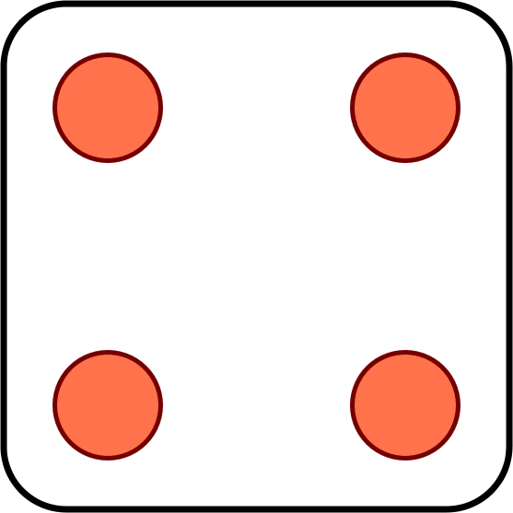

Problem for you to solve
Toss 2 dice. You win if the sum of the outcomes is 8.
The first die comes out to a 4. Should you be happy?
?
Now suppose you win if the sum is 7. Your first toss is a 4. Should you be happy?

Slide 6
1 Conditional probability
F
The conditional probability P(A | F) represents the probability of event A assuming event F happened.
S
A
Conditional probabilities with respect to the reduced sample space F are given by the formula
P(AF)
P(A | F) =
P(F)

Slide 7
Example 1
A box contains 3 cards. One is black on both sides. One is red on both sides. One is black on one side and red on the other.
You draw a random card and see a black side. What are the chances the other side is red?
A: 1/4
B: 1/3
C: 1/2

Slide 8
Solution
B1
B2
B3
S = { F1, B1, F2, B2, F3, B3 }
F1
F2
F3
equally likely outcomes
The event you see a black side is SB = { F1, B1, F3 }
The event the other side is red is OR = { F2, B2, F3 }
P(OR SB)
1/|S|
P(OR | SB) =
=
= 1/3
P(SB)
3/|S|

Slide 9
The multiplication rule
P(E₁E₂)
Using the formula
P(E₂|E₁) =
P(E₁)
We can calculate the probability of intersection
P(E₁E₂) = P(E₁) P(E₂|E₁)
In general for n events
P(E₁E₂…E_{n}) = P(E₁) P(E₂|E₁)…P(E_{n}|E₁…E_{n-1})

Slide 10
Example 2 Using conditional probabilities
There are 8 red balls and 8 blue balls in an urn. You draw at random without replacement. What is the probability the first two balls are red?
Solution 1: without conditional probabilities
S = arrangements of r red and b blue balls
E = arrangements in which the first two are red
|E|
14! / (6! 8!)
8 ∙ 7
P(E) =
=
=
|S|
16! / (8! 8!)
16 ∙ 15

Slide 11
Example 2 Using conditional probabilities
Solution 2: using conditional probabilities
R₁ = arrangements in which the first ball is red
R₂ = arrangements in which the second ball is red
P(R₁R₂) = P(R₁) P(R₂|R₁)
= (8/16) (7/15)
P(R₁) = 8/16
Given the first ball is red, we are left with 7 red and 8 blue balls under equally likely outcomes
P(R₂|R₁) = 7/15

Slide 12
Example 3 Cards
You divide 52 cards evenly among 4 people. What is the probability everyone gets an ace?
S = all ways to divide 52 cards among 4 people
equally likely outcomes
E = everyone gets an ace
= A♠ A♣ A♥ A♦ are assigned to different people
E₃ = A♣ A♥ A♦ are all assigned to different people
E₂ = A♥ A♦ are all assigned to different people
P(E) = P(E₂) P(E₃|E₂) P(E|E₂E₃)

Slide 13
Example 3 Cards
E₂ = A♥ A♦ are assigned to different people
After assigning A♥ it looks like this:
?
?
?
?
?
?
?
?
?
?
?
?
?
?
?
?
?
?
?
?
?
?
?
?
?
?
?
?
?
?
?
?
?
?
A♥
?
?
?
?
?
?
?
?
?
?
?
?
?
?
?
?
?
P(E₂) =
# grey cards
= 3 ∙ 13/(52 – 1) = 39/51
# of question marks

Slide 14
Example 3 Cards
E₃ = A♣ A♥ A♦ are all assigned to different people
After E₂ it looks like this:
?
?
?
A♦
?
?
?
?
?
?
?
?
?
?
?
?
?
?
?
?
?
?
?
?
?
?
?
?
?
?
?
?
?
?
A♥
?
?
?
?
?
?
?
?
?
?
?
?
?
?
?
?
?
P(E₃|E₂) = 2 ∙ 13/(52 – 2) = 26/50

Slide 15
Example 3 Cards
E₂ = A♥ A♦ are assigned to different people
P(E₂) = 3 ∙ 13/(52 – 1) = 39/51
E₃ = A♣ A♥ A♦ are all assigned to different people
P(E₃ | E₂) = 2 ∙ 13/(52 – 2) = 26/50
E = A♠ A♣ A♥ A♦ all assigned to different people
P(E | E₃) = 13/(52 – 3) = 13/49
P(E) = (39/51) (26/50) (13/49) ≈ .105

Slide 16
Rule of average conditional probabilities
F
F^{c}
P(E)
= P(EF) + P(EF^{c})
S
E
= P(E|F)P(F) + P(E|F^{c})P(F^{c})
Law of total probability (LOTP)
F₃
F₁
F₄
More generally, if F₁,…, F_{n}
partition S then
E
F₂
F₅
P(E) = P(E|F₁)P(F₁) + … + P(E|F_{n})P(F_{n})

Slide 17
Example 4 Multiple choice
What is the capital of Macedonia?
A: Split
B: Struga
C: Skopje
D: Sarajevo
What probability is that a student know the answer?

Slide 18
Multiple choice test
Probability model
There are two types of students:
Type K: Knows the answer
Type K^{c}: Picks a random answer
Event C: Student gives correct answer
P(C) = p = fraction of correct answers
p = P(C|K)P(K) + P(C|K^{c})P(K^{c})
= 1/4 + 3P(K)/4
1
1/4
1 - P(K)
P(K) = (p – ¼) / ¾

Slide 19
Example 5 Red and blue balls again
There are 8 red balls and 6 blue balls in an urn. You draw at random without replacement. What is the probability the first two balls are of the same color?
event E
Solution:
Let R₁ be the event “the first ball is red”
R₂ be “the second ball is red”
P(E) = P(E|R₁)P(R₁) + P(E|R₁^{c})P(R₁^{c})
= P(R₂|R₁)P(R₁) + P(R₂^{c}|R₁^{c})P(R₁^{c})
= 86/182
7/13
8/14
5/13
6/14

Slide 20
Example 5 Boxes
1
2
3
I choose a cup at random and then a random ball from that cup. The ball is blue. You need to guess where the ball came from.
(a) Which cup would you guess?
(b) What is the probability you are correct?

Slide 21
Example 5 Boxes
1
2
22
3
32
11
21
31
34
12
23
33
S = { 11, 12, 21, 22, 23, 31, 32, 33, 34 }
outcomes are not equally likely!
The events of interest are:
BLUE = blue ball = { 11, 21, 22, 31, 32, 33 }
CUP₁ = first cup = { 11, 12 }
CUP₂ = { 21, 22, 23 }
CUP₃ = { 31, 32, 33, 34 }

Slide 22
Example 5 Boxes
1
2
22
3
32
11
21
31
34
12
23
33
S = { 11, 12, 21, 22, 23, 31, 32, 33, 34 }
1/6
1/6
1/9
1/9
1/9
1/12
1/12
1/12
1/12
P(CUP₁|BLUE) = P(CUP₁ BLUE) / P(BLUE)
= 1 ∙ 1/6 / (3 ∙ 1/12 + 2 ∙ 1/9 + 1 ∙ 1/6)
= 6/23
P(CUP₂|BLUE) = 8/23
P(CUP₃|BLUE) = 9/23

Slide 23
Example 5 Boxes
Another way to present the solution:
1
2
22
3
32
11
21
31
34
12
23
33
P(CUP_{i}|BLUE) = P(CUP_{i} BLUE) / P(BLUE)
P(CUP_{i} BLUE) = P(BLUE | CUP_{i} ) P(CUP_{i})
i
1
2
3
1/3
1/2
2/3
3/4
P(BLUE) = 1/2 1/3 + 2/3 1/3 + 3/4 1/3 = 23/36

Slide 24
Exercise
1
2
3
Same as before, but now the ball is red.
(a) Which cup would you guess it came from?
(b) What is the probability you are correct?

Slide 25
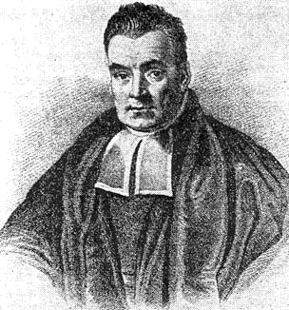
2 Bayes Formula
P(E|F) P(F)
P(E|F) P(F)
P(F|E) =
=
P(E)
P(E|F) P(F) + P(E|F^{c}) P(F^{c})
More generally, if F₁,…, F_{n} partition S then
P(E|F_{i}) P(F_{i})
P(F_{i}|E) =
P(E|F₁) P(F₁) + … + P(E|F_{n}) P(F_{n})
Two cases:
E is result, F is reason
E happens later, F happens early.

Slide 26
Example 6 Medical tests
If a person is sick (S), a blood test comes out positive (P) 95% of the time.
If he is not sick, the test is positive 5% of the time.
Suppose 1% people in China are sick.
He takes the test and come out positive. What are the chances that you are sick?
P(P|S) P(S)
P(S|P) =
≈ 16.1%
P(P|S) P(S) + P(P|S^{c}) P(S^{c})
95% 1%
5% 99%

Slide 27
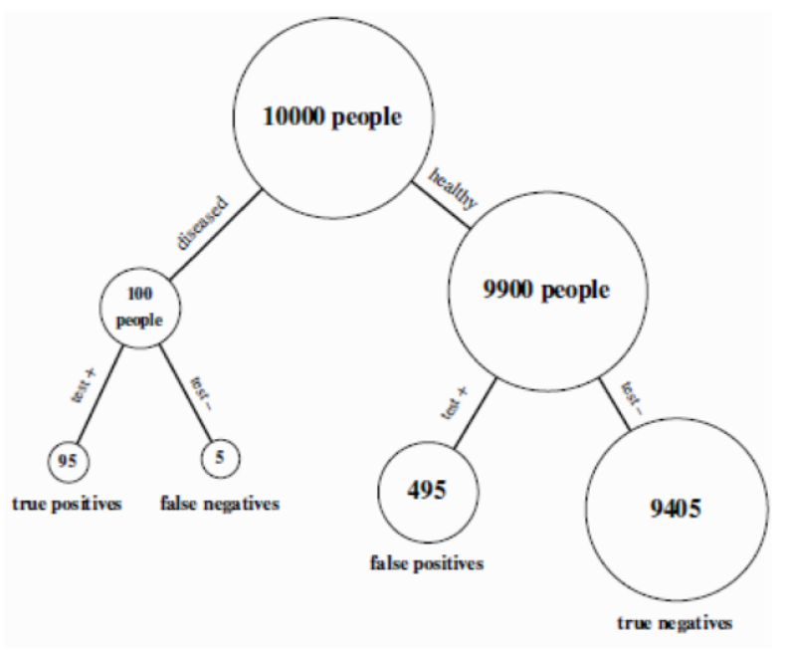
Example 6 Explain

Slide 28
Exercise
An insurance company believes that people can be divided into two classes: those who are accident prone and those who are not. The company’s statistics show that an accident-prone person will have an accident at some time within a fixed 1-year period with probability .4, whereas this probability decreases to .2 for a person who is not accident prone. If we assume that 30 percent of the population is accident prone, what is the probability that a new policyholder will have an accident within a year of purchasing a policy?
Notes:
Example 3a

Slide 29


Example 7 Russian roulette
Alice
Bob
BANG
Alice and Bob take turns spinning the 6 hole cylinder and shooting at each other.
What is the probability that Alice wins (Bob dies)?

Slide 30
Example 7 Russian roulette
Probability model
S = { H, MH, MMH, MMMH, MMMMH, …}
E.g. MMH: Alice misses, then Bob misses, then Alice kills
A = “Alice wins” = { H, MMH, MMMMH, …}
outcomes are not equally likely!

Slide 31
Example 7 Russian roulette
outcome H MH MMH MMMH MMMMH
probability
1/6
5/6 ∙ 1/6
(5/6)² ∙ 1/6
(5/6)³ ∙ 1/6
(5/6)⁴ ∙ 1/6
A = “Alice wins” = { H, MMH, MMMMH, …}
P(A)
= 1/6 + (5/6)² ∙ 1/6 + (5/6)⁴ ∙ 1/6 + …
= 1/6 ∙ (1 + (5/6)² + (5/6)⁴ + …)
= 1/6 ∙ 1/(1 – (5/6)²)
= 6/11

Slide 32
Example 7 Russian roulette
Solution using conditional probabilities:
A = “Alice wins” = { H, MMH, MMMMH, …}
A^{c} = “Bob wins” = { MH, MMMH, MMMMMH, …}
W₁ = “Alice wins in first round” = { H }
P(A) = P(A|W₁) P(W₁) + P(A|W₁^{c}) P(W₁^{c})
1
1/6
P(A^{c})
5/6
P(A) = 1 ∙ 1/6 + (1 – P(A)) ∙ 5/6
11/6 P(A) = 1
so P(A) = 6/11

Slide 33
Infinite sample spaces
Axioms of probability:
1. for every E, 0 ≤ P(E) ≤ 1
S
E
2. P(S) = 1
S
3. If EF = ∅ then
S
P(E∪F) = P(E) + P(F)
E
F
3. If E₁, E₂, … are pairwise disjoint:
P(E₁∪E₂∪…) = P(E₁) + P(E₂) + …

Slide 34
Exercise
Charlie tosses a pair of dice. Alice wins if the sum is 7. Bob wins if the sum is 8.
Charlie keeps tossing until one of them wins.
What is the probability that Alice wins?

Slide 35
3 Independent Events
Let E₁ be “first coin comes up H”
E₂ be “second coin comes up H”
Then P(E₂ | E₁) = P(E₂)
P(E₂E₁) = P(E₂)P(E₁)
Events A and B are independent if
P(A B) = P(A) P(B)
Independence is completely diﬀerent from disjointness
Disjointness: P(AB)=0

Slide 36
Algebra of independent events
If A and B are independent, then A and B^{c} are also independent.
Proof: Assume A and B are independent.
P(B^{c} | A)
= 1 – P(B | A)
= 1 – P(B)
= P(B^{c})
so B^{c} and A are independent.
Taking complements preserves independence.

Slide 37

Examples of (in)dependence
Let E₁ be “first die is a 4”
S₆ be “sum of dice is a 6”
S₇ be “sum of dice is a 7”
P(E₁) = 1/6
P(E₁S₆) = 1/36
E₁, S₆ are dependent
P(S₆) = 5/36
P(S₇) = 1/6
P(E₁S₇) = 1/36
E₁, S₇ are independent
P(S₆S₇) = 0
S₆, S₇ are dependent

Slide 38


Example 8 Reliability of sequential components
SWU
Jinyun
Jiayue
Airport
W_{JYT}: “Jinyun tunnel is operational”
P(W_{JYT}) = 90%
W_{JYB}: “Jiayue bridge is operational”
P(W_{JYB}) = 98%
W: “The road is operational”
Assuming events W_{JYT} and W_{JYB} are independent:
P(W) = P(W_{JYT} W_{JYB}) = P(W_{JYT})P(W_{JYB}) = 88.2%

Slide 39

Example 9 Reliability of parallel components
Two cars go to Shapingba station in different ways:
85%
Raocheng
95%
Shapingba station
SWU
Kuaisu
Assuming W_{RC} and W_{KS} are independent:
P(W) = P(W_{RC}∪W_{KS})
P(W^{c}) = P(W_{RC}^{c}W_{KS}^{c}) = P(W_{RC}^{c})P(W_{KS}^{c})
P(W) = 1 – P(W_{RC}^{c})P(W_{KS}^{c}) = 1 – 15% 5% = 99.25%

Slide 40
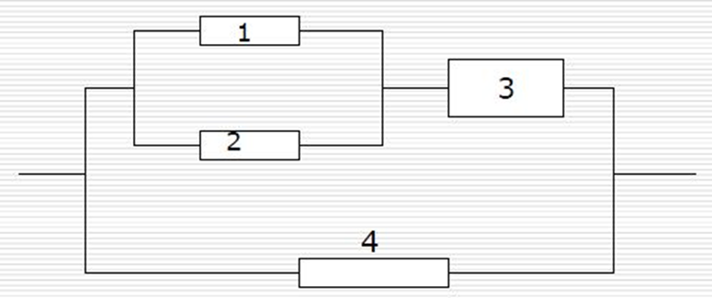
Exercise
A electronic system as follows: each component’s reliability is p

Slide 41
Independence of three events
Events A, B, and C are independent if
P(AB) = P(A) P(B)
P(BC) = P(B) P(C)
P(AC) = P(B) P(C)
and P(ABC) = P(A) P(B) P(C).
This is important!

Slide 42
(In)dependence of three events
Let E₁ be “first die is a 4”
E₂ be “second die is a 3”
S₇ be “sum of dice is a 7”
✔
P(E₁E₂) = P(E₁) P(E₂)
1/6
✔
E₁
P(E₁S₇) = P(E₁) P(S₇)
✔
P(E₂S₇) = P(E₂) P(S₇)
1/36
E₂
S₇
✗
P(E₁E₂S₇) = P(E₁) P(E₂) P(S₇)
1/6
1/6
1/36
1/6
1/6
1/6

Slide 43
Independence of many events
Events A₁, A₂, … are independent if for every subset A_{i1}, …, A_{ir} of the events
P(A_{i1}…A_{ir}) = P(A_{i1}) … P(A_{ir})
Algebra of independent events
Independence is preserved if we replace some event(s) by their complements, intersections, unions

Slide 44

Example 10 Playoffs
Alice wins 60% of her ping pong matches against Bob. They meet for a 3 match playoff. What are the chances that Alice will win the playoff?
Probability model
Let W_{i} be the event Alice wins match i
We assume P(W₁) = P(W₂) = P(W₃) = 0.6
We also assume W₁, W₂, W₃ are independent

Slide 45
Example 10 Playoffs
Probability model
To convince ourselves this is a probability model, let’s redo it the usual way
S = { AAA, AAB, ABA, ABB, BAA, BAB, BBA, BBB }
the probability of AAA is P(W₁W₂W₃) = 0.6³
AAB
P(W₁W₂W₃^{c}) = 0.6² ∙ 0.4
ABA
P(W₁W₂^{c}W₃) = 0.6² ∙ 0.4
…
…
BBB
P(W₁^{c}W₂^{c}W₃^{c}) = 0.4³
The probabilities add up to one.

Slide 46
Example 10 Playoffs
For Alice to win the tournament, she must win at least 2 out of 3 games. The corresponding event is
A = { AAA, AAB, ABA, BAA }
0.6³
0.6² ∙ 0.4 each
P(A) = 0.6³ + 3 ∙ 0.6² ∙ 0.4 = 0.648.
General playoff
Alice wins a p fraction of her ping pong games against Bob. What are the chances Alice beats Bob in an n match tournament (n is odd)?

Slide 47
Example 10 Playoffs
Solution
Probability model similar as before.
Let A be the event “Alice wins playoff”
A_{k} be the event “Alice wins exactly k matches”
A = A_{(n+1)/2}∪…∪A_{n}
P(A) = P(A_{(n+1)/2}) + … + P(A_{n}) (they are disjoint)
P(A_{k}) = C(n, k) p^{k} (1 – p)^{n - k}
number of arrangements of k As, n – k Bs
probability of each such arrangement

Slide 48
Example 10 Playoffs
P(A) = ∑ _{k = (n+1)/2}
C(n, k) p^{k} (1 – p)^{n - k}
^{n}
p = 0.6
p = 0.7
n
n
The probability that Alice wins an n game tournament

Slide 49
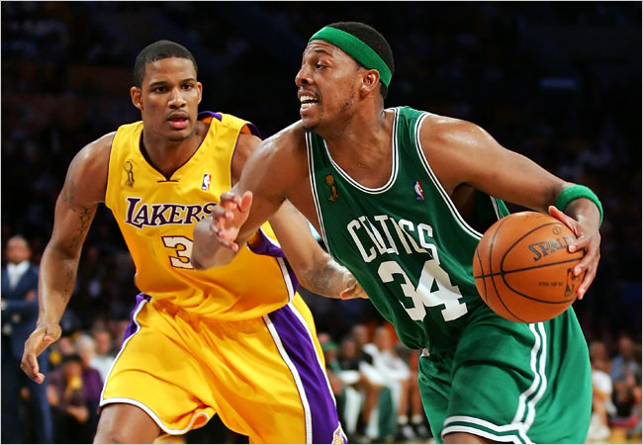
Exercise
The Lakers and the Celtics meet for a 7-game playoff. They play until one team wins four games.
Suppose the Lakers win 60% of the time. What is the probability that all 7 games are played?

Slide 50

Example 11 Gambler’s ruin
You have $100. You keep betting $1 on red at roulette.
You stop when you win $200, or when you run out of money.
What is the probability you win $200?

Slide 51
Example 11 Gambler’s ruin
Probability model
S = all infinite sequences of Reds and Others
Let R_{i} be the event of red in the i th round (there is an R in position i )
Probabilities:
call this p
P(R₁) = P(R₂) = … = 18/37
R₁, R₂, … are independent

Slide 52
Example 11 Gambler’s ruin
$n
You have $100. You stop when you win $200.
Let W be the event you win $200 and w_{n} = P(W).
w_{n} = P(W)
= P(W|R₁) P(R₁) + P(W|R₁^{c}) P(R₁^{c})
w_{n+1}
p
w_{n-1}
1-p
w_{n} = (1-p)w_{n-1} + pw_{n+1}
w₀ = 0
w₂₀₀ = 1.

Slide 53
Example 11 Gambler’s ruin
w_{n} = (1-p)w_{n-1} + pw_{n+1}
w₀ = 0
w₂₀₀ = 1.
p(w_{n+1} – w_{n} ) = (1-p)(w_{n} – w_{n-1})
let λ = (1-p)/p = 19/18
w_{n+1} – w_{n} = λ (w_{n} – w_{n-1})
= λ² (w_{n-1} – w_{n-2})
= … = λ^{n} (w₁ – w₀)
w_{n+1} = w_{n} + λ^{n}w₁
= w_{n-1} + λ^{n-1}w₁ + λ^{n}w₁
= … = w₁ + λw₁ + … + λ^{n}w₁

Slide 54
Example 11 Gambler’s ruin
w_{n} = (1-p)w_{n-1} + pw_{n+1}
You have $100.
w₀ = 0
w₂₀₀ = 1.
You stop when you win
$200 or run out.
λ = (1-p)/p = 19/18
The probability you win is
w_{n+1} = w₁ + … + λ^{n}w₁
w₁₀₀ ≈ 0.0045
= (λ^{n+1} – 1)/(λ – 1)w₁
w₂₀₀ = (λ²⁰⁰ – 1)/(λ – 1)w₁
λ^{n+1} – 1
w_{n+1} =
λ²⁰⁰ – 1

Slide 55
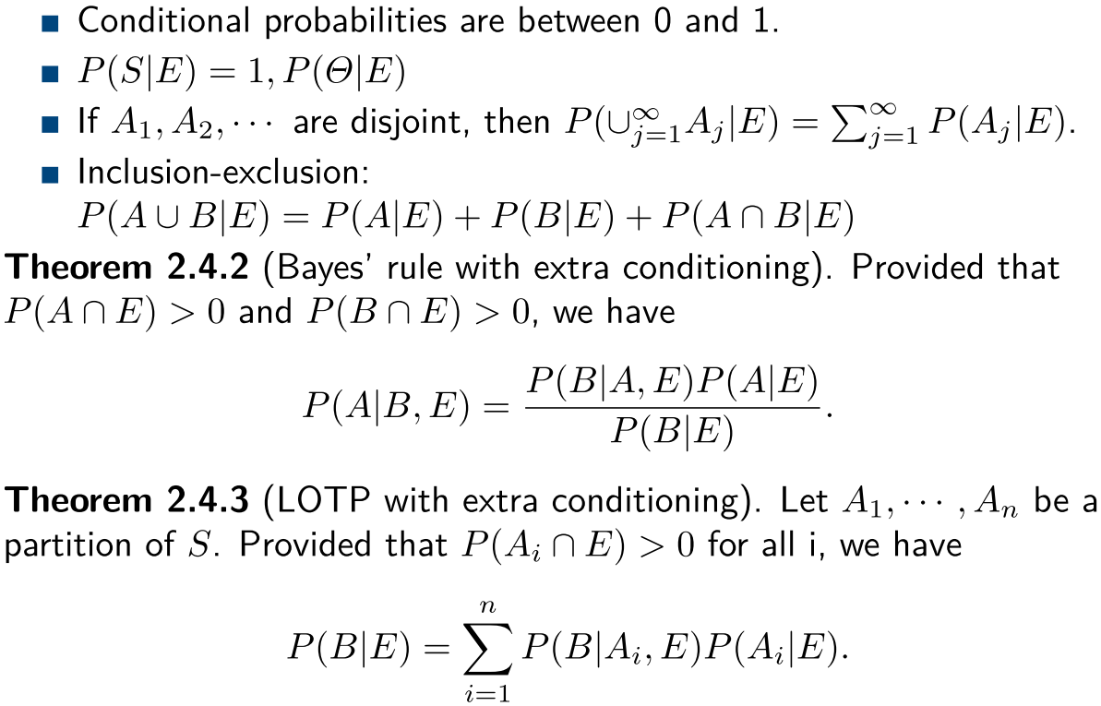
4 P(ꞏ|F) Is a Probability
Theorem 1
=0
_
Theorem 2
Theorem 3

Slide 56
Example 12
An insurance company that believes that people can be divided into two distinct classes: those who are accident prone and those who are not. During any given year, an accident-prone person will have an accident with probability 0.4, whereas the corresponding figure for a person who is not prone to accidents is 0.2. If we assume that 30 percent of the population is accident prone, What is the conditional probability that a new policyholder will have an accident in his or her second year of policy ownership, given that the policyholder had an accident in the first year?
Let A₁ : the even had an accident in the first year
A₂ : the even had an accident in the second year
A : the even he is accident-prone
P(A₂ | A₁)
A₂ = A₂ A∪ A₂ A^{c}
Notes:
See bayes’ rule exercise

Slide 57
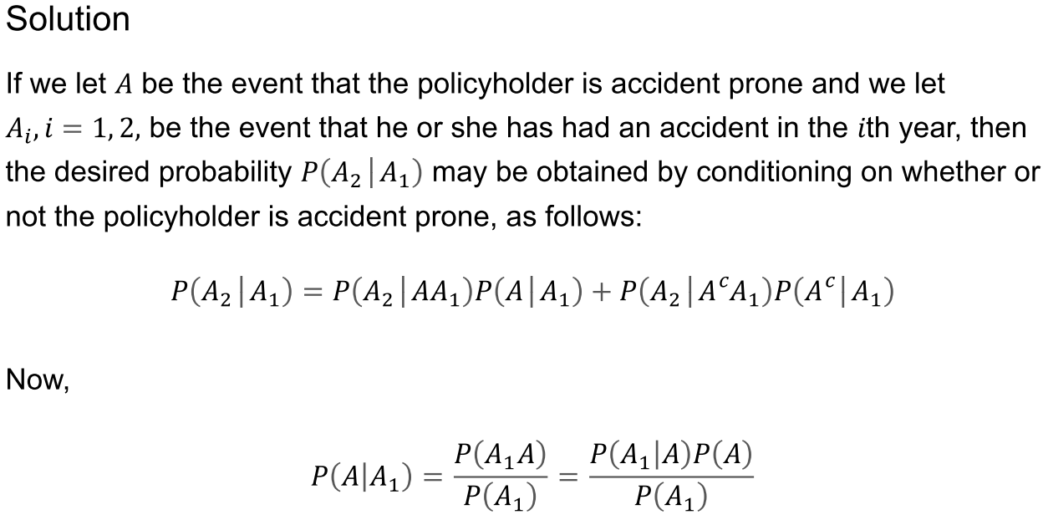
Example 12
0.4
0.2
0.4
0.3
P(A₁)=P(A₁ A)+P(A₁ A^{c} )
Notes:
See bayes’ rule exercise

